Slide 1

Portuguese Bank Marketing
By: Lisa Patel
Thanks to Springboard Mentor Dipanjan Sarkar
Notes:
Since a majority of people put their financial trust in banks, it is especially crucial for them to have trusting relationships with their customers as well as a reputable brand. Banks, as many other entities, can do all that and more through conducting data driven research in their marketing departments. By analyzing customer demographics, their usage and past marketing campaigns, a bank can create engaging and strategic marketing campaigns in the future that can boost sales and build better brand awareness, reputation and customer relationships. To see this in action, take the Portuguese retail bank, which has seen a revenue decline and following a further investigation, found that the root cause is that their clients are not depositing as frequently as before. We know that term deposits, which are the cash investments held at a financial institution, are a major source of income for banks since they allow banks to invest in other, more profitable financial products. As a result, the Portuguese bank would like to identify and predict existing clients that have a higher chance to subscribe for a term deposit and focus future marketing efforts on such clients.

Slide 2
Motivation & Background
Improve marketing campaign of a Portuguese bank by analyzing their past marketing campaign data and predicting if a client will buy a fixed-term deposit or not.
Why? By creating a prediction algorithms, the bank can better target its customers and better channel its marketing efforts for increased revenue and reduced marketing costs.
Data was collected about each client, type of contact and outcome.
20 features (mix of categorical and numerical). Target variable was binary (“Yes” or “No”)
41,118 instances - No missing values for any feature.
Notes:
The marketing campaigns were based on phone calls. So this dataset has details of all the calls that were made in the previous marketing campaign
the study of consumers helps firms and organizations to improve their marketing strategies by understanding issues such as the psychology, mindset, behavior and motivation of consumers

Slide 3
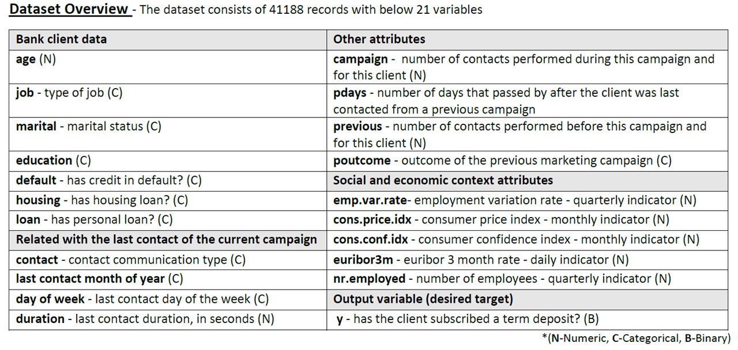
Notes:
cons.conf.idx: consumer confidence index, measures how optimistic or pessimistic consumers are regarding their expected financial situation - monthly indicator (numeric)
euribor3m: euribor 3 month rate, the interest rate at which a selection of European banks lend one another funds denominated in euros whereby the loans have a maturity of 3 months - daily indicator (numeric)

Slide 4
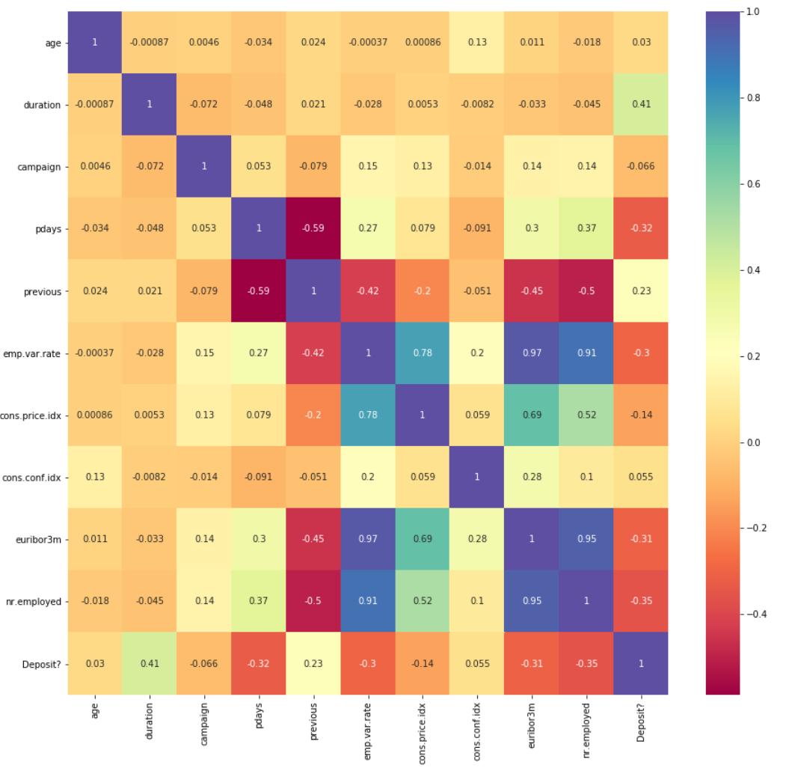
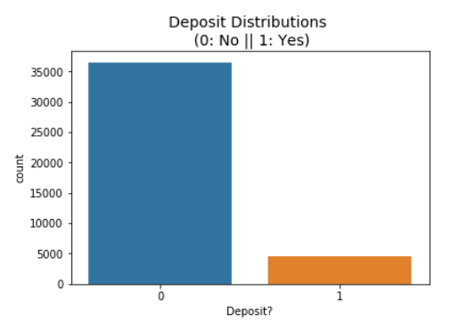
Heatmap shows most correlation with social & economic context attributes.
(+): emp.var.rate, nr.employed, cons.price.idx & eurobor3m highly correlated with each other, which is expected
(-): emp.var.rate & previous, pdays & previous
Highly imbalanced
Notes:
Employment variation rate & number of employees
this attribute highly affects the output target (e.g., if duration=0 then y='no'). Yet, the duration is not known before a call is performed. Also, after the end of the call y is obviously known. Thus, this input should only be included for benchmark purposes and should be discarded if the intention is to have a realistic predictive model.

Slide 5
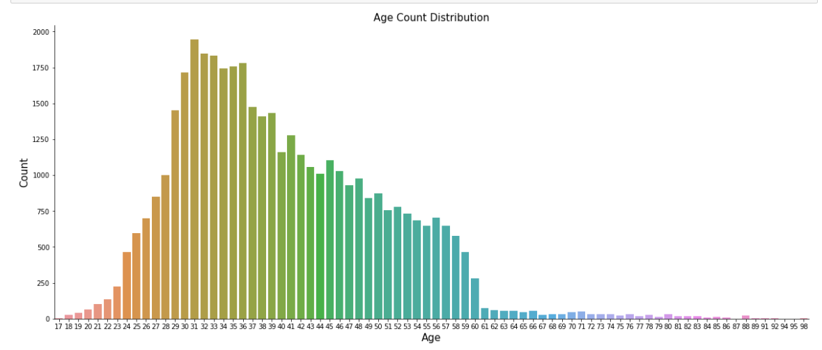
Age distribution shows clients in the age range 30-50 yrs forms a major portion and can be targeted clients for further analysis
Notes:
27-37

Slide 6
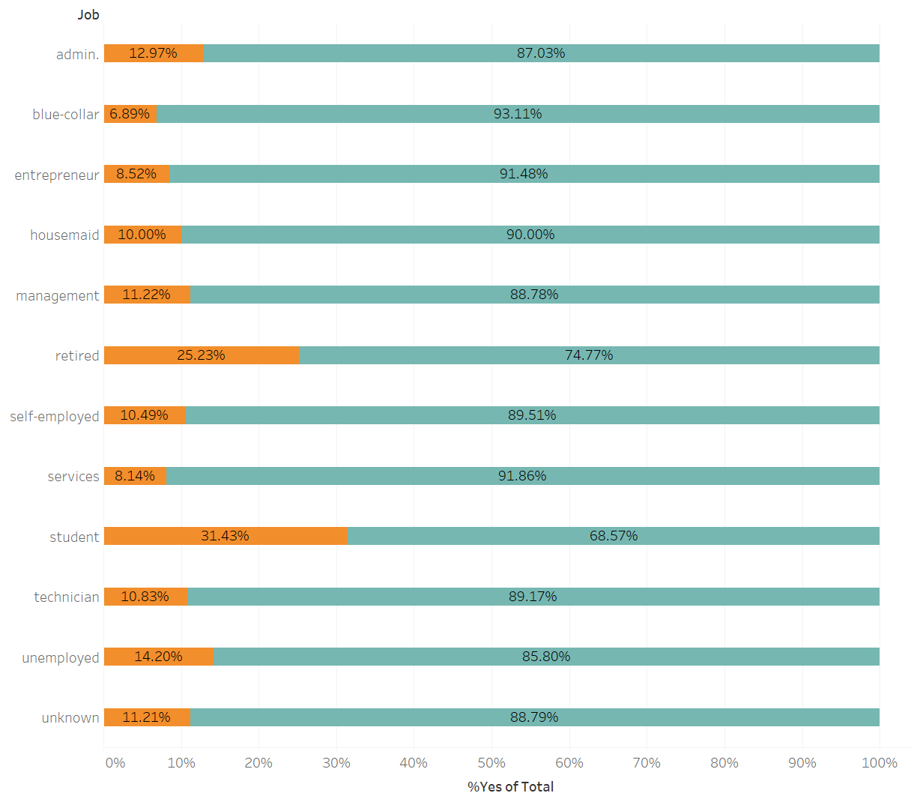
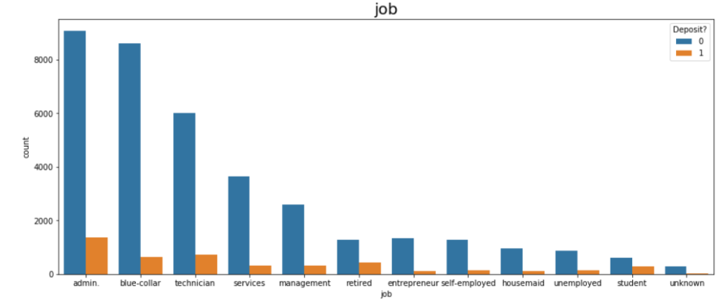
Overall, JOB does not seem to be a good predictor of success.
Although there does appear to be greater success among students, retirees and admin professionals, they represent relatively small numbers within the overall campaign.
Notes:
Job: Overall job does not appear to be much of a predictor of success for the marketing campaign. Although there does appear to be greater success among students, retirees and admin professionals, they represent relatively small numbers within the overall campaign. It could be a sigh that this particular product was well suited to them.
Marital: Success among married and divorced people appear roughly the same, but there is much more success among single people. That may turn out to be a good predictor.
Education: Success seems a little more evenly distributed here. It appears high among the illiterate, but they represent a very number of the total count. University educated individuals seem to respond well, and they are the largest group in the data. This may be a good predictor.
Default: Those that have not defaulted on a loan are much more likely to successfully become customers than our unknowns, and at a slightly higher average (~12.5%) than the overall average (~10%)
Housing: Whether or not someone has a home loan does not appear to have much of a relationship with the success of the campaign.
Loan: Personal loans also do not appear to be much of a predictor
Contact: Customers contacted via cellular phone appear to be much more likely to be successful prospects, this is interesting. Cellular customers were also contact more, but not with too much imbalance.
Month: Month does not appear to have a very significant effect. There are months with very high success rates, but those are often months that also have very low relative counts. It would be interesting to know if those are follow-ups in the later months, or return customers or warm leads in the early months. Overall it appears that the majority of the campaign occured between May and August
Day of week: Day of week does not seem to have a large amount of significance, but the middle days do appear to be slightly more successful than Monday and Friday.
Poutcome: The outcome of the previous marketing campaign does appear to have an effect. Even though it is a very small number, prior success seems to suggest later success. And, those that were contacted and failed also are more successful, indicating that returning to previous targets may have value.
Pcontacted: Those that had been previously contacted in the campaign ended up signing up at a rate of 60%, that is very high, even though the overall count of these individuals is small. This variable is tough to interpret because intuitively it makes sense that customers that have been contacted before are more likely to have signed up than those called for the first time simply because they have been given more opportunities to say "yes". There are a number of reasons these people may have been called more that once that do not suggest a greater amount of calls necessarily results in greater customer conversion, but it also suggest that customers that are leaning yes may be more likely converted with persistence.
Variables to keep an eye on are: Pcontacted, job_student, job_retired, marital_single, contact_cellular

Slide 7
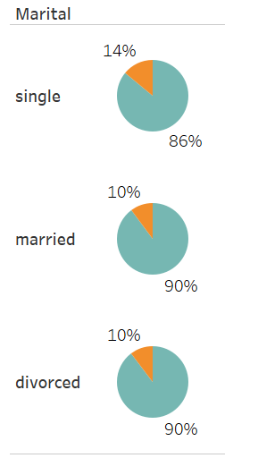
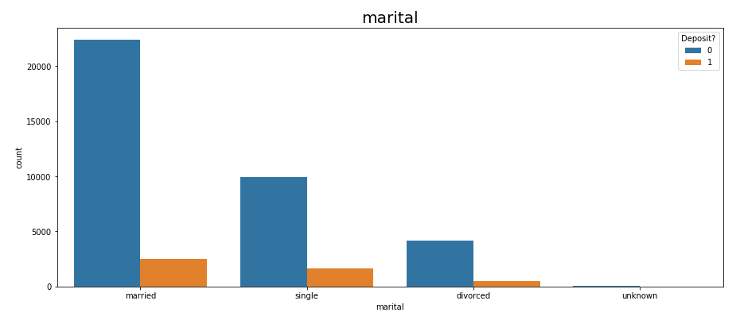
Success among married and divorced people appear roughly the same, but there is much slightly more success among single people. That may turn out to be a good predictor.

Slide 8
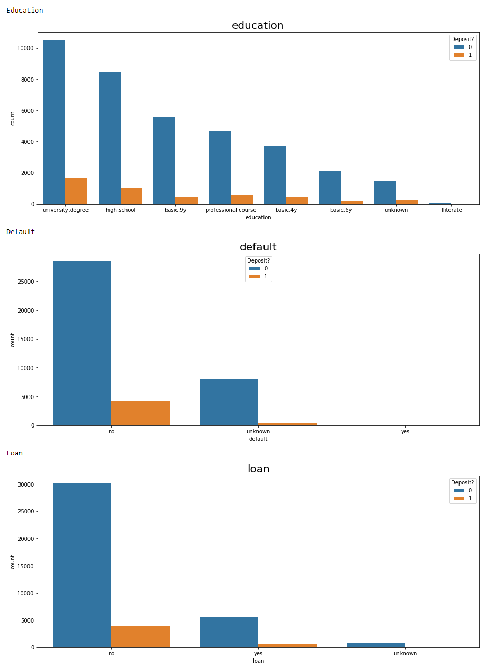
Individuals with university and high school education seem to respond well, and they are the largest group in the data.
Default among those who answer ‘yes’ to a term deposit is non-existent. Ultimately removed due to high number of unknowns
Personal loans also don’t appear to be much of a predictor.
Notes:
Education: Success seems a little more evenly distributed here. It appears high among the illiterate, but they represent a very number of the total count. University educated individuals seem to respond well, and they are the largest group in the data. This may be a good predictor.
Default: Those that have not defaulted on a loan are much more likely to successfully become customers than our unknowns, and at a slightly higher average (~12.5%) than the overall average (~10%)
Housing: Whether or not someone has a home loan does not appear to have much of a relationship with the success of the campaign.
Loan: Personal loans also do not appear to be much of a predictor

Slide 9
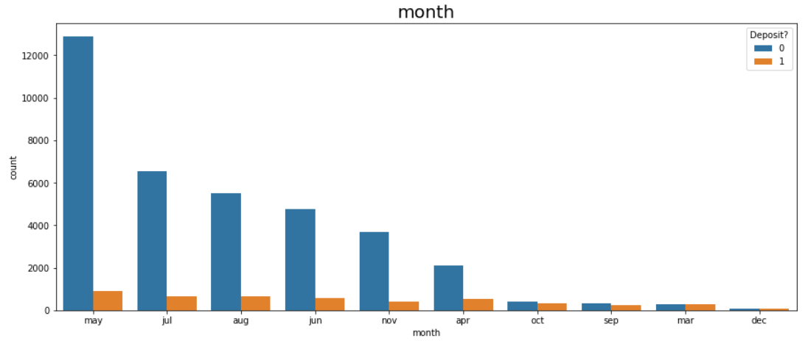
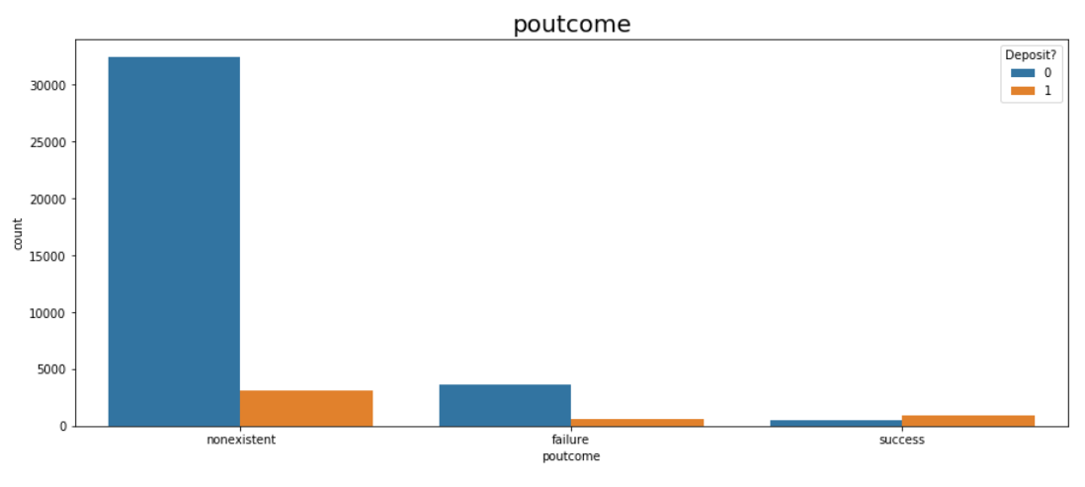
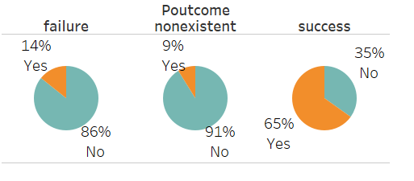
Month and Previous Outcome
Majority of campaigns occurred between May and August.
Prior success seems to suggest later success.
Notes:
Month does not appear to have a very significant effect. There are months with very high success rates, but those are often months that also have very low relative counts. It would be interesting to know if those are follow-ups in the later months, or return customers or warm leads in the early months. Overall it appears that the majority of the campaign occured between May and August
The outcome of the previous marketing campaign does appear to have an effect. Even though it is a very small number, prior success seems to suggest later success. And, those that were contacted and failed also are more successful, indicating that returning to previous targets may have value.

Slide 10
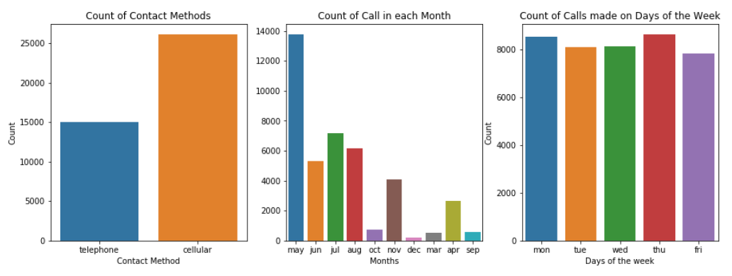
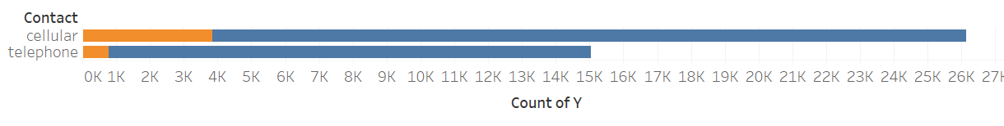
No significant effect for calls made on certain days
Customers contacted via cellular phone appear to be much more likely to be successful prospects. Cellular customers were also contacted more, but not with too much imbalance

Slide 11
Pre-Processing & Modeling
Get dummies: ML models largely cannot read text strings, so we will transform our categorical variables into series of 0's and 1's with one-hot encoding
Scale data: transform the variable so that they have a similar scale (StandardScaler)
Train-test split: Split our data up into our training and test sets (70/30 split)
Run Models and hyper-parameterize: Logistic Regression, Decision Tree, Random Forest
Deal with class imbalance: apply SMOTE in order to try to adjust for the imbalance in our label data and rerun models
Notes:
Class Imbalance - SMOTE
As we've seen above we have somewhat of a class imbalance issue. Only ~11% of our label data is a "yes" or "1". This needs to be accounted for in order to keep the model from being accurate by simply predicting the right outcome 89% of the time, which is already the prevalence of 0's in the data.
One way of addressing this issue is through oversampling our positive data. To do this, we will use the Synthetic Minority Oversampling Technique (SMOTE). SMOTE generates new sample data for the minority class (in this case a 1 for 'y_yes' by creating 'synthetic' samples that are combinations of the closest minority class observations.

Slide 12
Model Evaluation Notes
Precision: Refers to how accurate the model is at predicting positive cases correctly - True Positive / (True Positive + False Positive)
Precision is a good metric to use when the costs of false positives are high. Example: Evidence that suggests a person is guilty of a crime (like DNA matching).
Recall: Refers to how many actual positives the model captures by labeling it correctly - True Positive / (True Positive + False Negative)
Recall is a good metric to use when the costs of false negatives are high. Example: Detecting fraud or serious illnesses - either example can have a serious effect for an organization that fails to detect fraud early enough,or for a patient that needs care or could potentially be contagious
F1 score: A balanced metric that combines precision and recall
Cost of a False Positive (we predict a customer will subscribe but they will not)?
We unnecessarily target them for more marketing - costing time and resources
We potentially annoy them by contacting them too much and turn them off from future campaigns
Cost of a False Negative (we predict a customer would not subscribe but they would)?
We do not target them with additional marketing when it may be productive
We potentially miss out on gaining this person as a customer
Prioritize Recall
Notes:
This metric is best used when seeking a balance between precision and recall and performs well with unbalanced data. It penalizes models that skew too heavily toward precision or recall, and therefore will only be high if both are high
t seems our trade-off is between the cost of marketing to a customer that is unlikely to subscribe and the missed revenue of failing to gain a customer that would subscribe. Let's assume that marketing to one additional customer has a relatively low cost, and the lifetime value of having an additional customer is relatively high. In this case, I would prioritze recall when evaluating my model metrics.

Slide 13
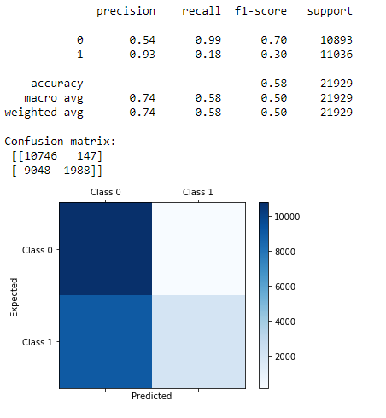
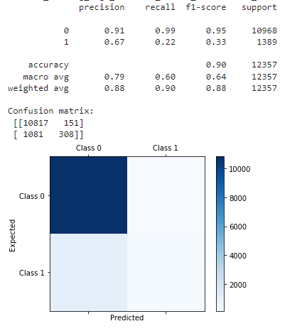
Logistic Regression w/o SMOTE
Logistic Regression w/ SMOTE
Notes:
a graphical plot that illustrates the diagnostic ability of a binary classifier system as its discrimination threshold is varied

Slide 14
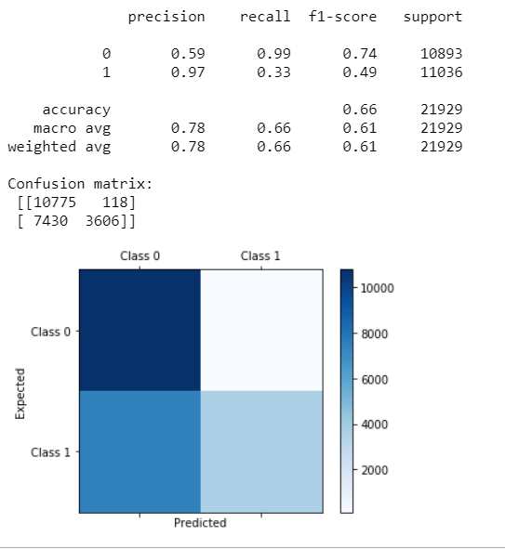
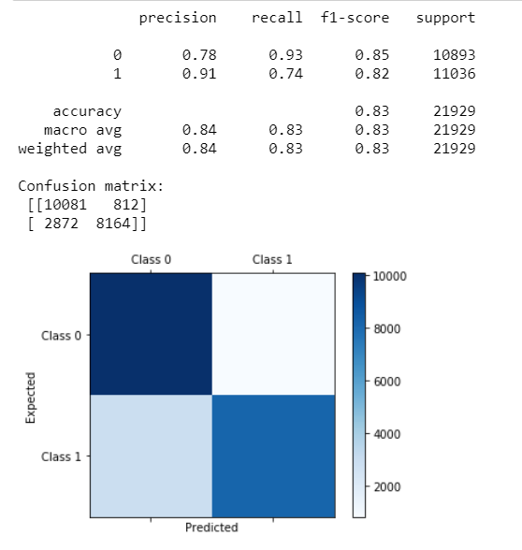
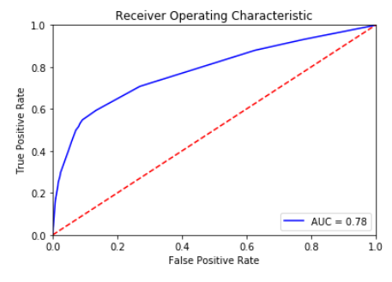
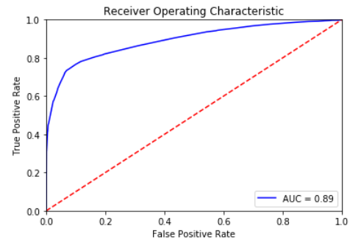
Decision Tree - w/o SMOTE
Decision Tree - w/ SMOTE
Notes:
AUC - ROC curve is a performance measurement for the classification problems at various threshold settings. ROC is a probability curve and AUC represents the degree or measure of separability. It tells how much the model is capable of distinguishing between classes. Higher the AUC, the better the model is at predicting 0 classes as 0 and 1 classes as 1.

Slide 15
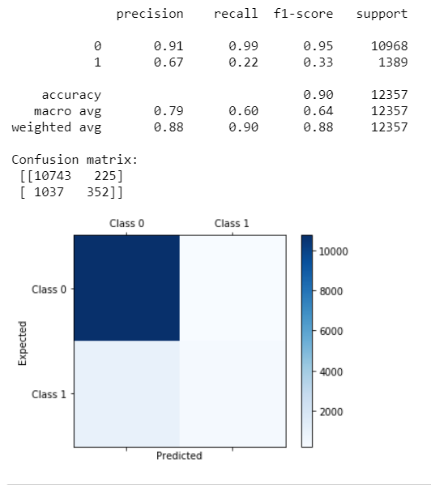
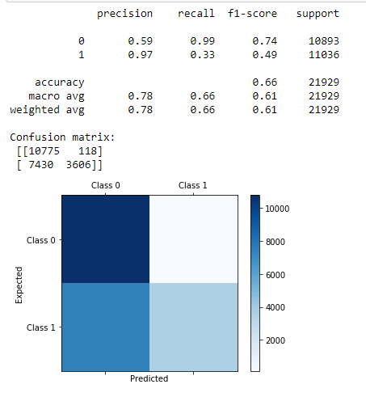
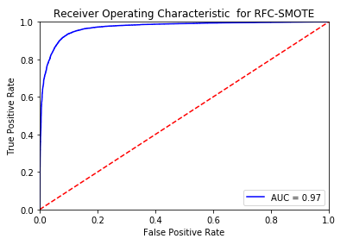
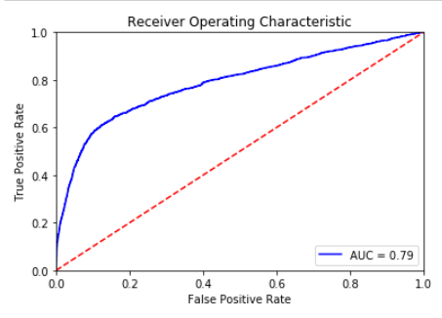
Random Forest Model w/o SMOTE
Random Forest Model w/ SMOTE

Slide 16
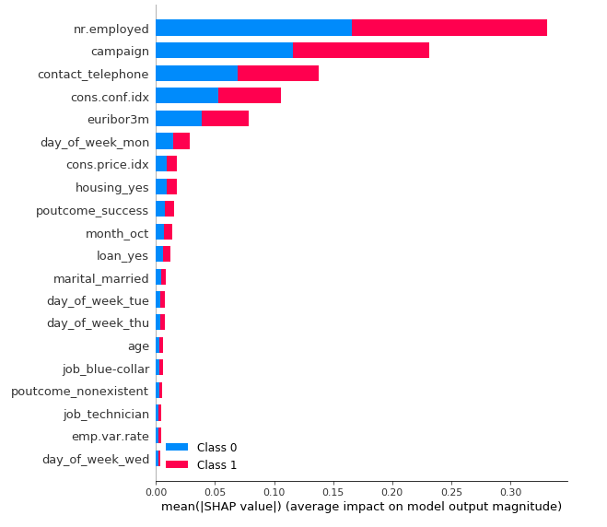
SHAP Feature Importances for Decision Tree
SHAP (SHapley Additive exPlanations) is a game theoretic approach to explain the output of any machine learning model.
Notes:
The classic ML metrics like accuracy, mean squared error, r2 score, etc does not give detailed insight into the performance of the model since we can have machine learning model which gives more than 90% accuracy for classification task but fails to recognize some classes properly due to imbalance data or model is actually detecting features which do not make sense to be used to predict particular class . Given that machine learning models are commonly getting used to solving many problems nowadays, it has become quite important to understand the performance of these models.A deep understanding of our ML models can help us decide the reliability of our ML models and whether it fit to be put into production. . One of the many python libraries available to debug model to better understand the model and its perfromance on any sample of the data is SHAP.
The SHAP stands for SHapley Additive exPlanations and uses the approach of game theory to interpret model predictions with Shapely values.They are measures of contributions each predictor (feature) has in a machine learning model.

Slide 17
Conclusion
Reach out to individuals from previous campaign as more than 50% will subscribe.
Contact customers via cell phone.
Decision Tree with SMOTE applied appears to be the best predictor for this problem. Consistently had the highest recall and therefore lowest false negative rate.

Slide 18
Thank you.
Source:
https://archive.ics.uci.edu/ml/datasets/bank+marketing
[Moro et al., 2014] S. Moro, P. Cortez and P. Rita. A Data-Driven Approach to Predict the Success of Bank Telemarketing. Decision Support Systems, Elsevier, 62:22-31, June 2014

